Slide 1
爐管新人學習進度報告
2020.08.03 ~ 2020.08.14
王堃龍
Notes:
115/11/08
Confidential

Slide 2
報告內容
一、兩週內PM內容
二、RCM 操作介面認識
三、RCM 管路圖
四、RCM FILL / BACK FILL 操作流程

Slide 3
一、兩周內工作內容
日期 | 機台 | PM項目 | 內容
2020/08/03 |  |  | 值日生
2020/08/04 |  |  | 值日生
2020/08/05 |  |  | 值日生
2020/08/06 |  |  | 值日生
2020/08/07
2020/08/10 |  |  | 值日生
2020/08/11 |  |  | 值日生
2020/08/12 |  |  | 值日生
2020/08/13 |  |  | 值日生
2020/08/14 |  |  | 值日生
Notes:
115/11/08
Confidential

Slide 4
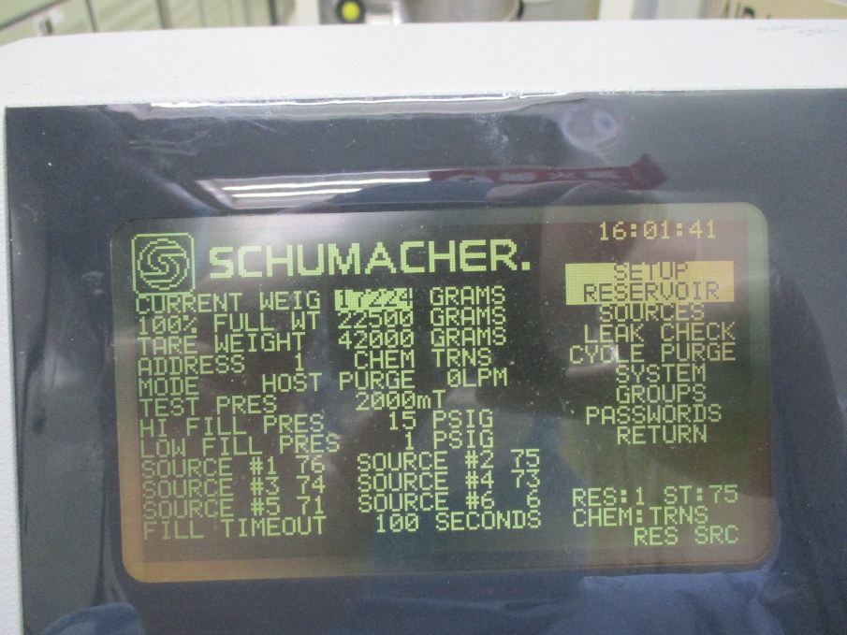
二、RCM 操作介面認識
SCHUMACHER.
CURRENT | WEIG | 17224 GRAMS |  | #76 | 55% | SETUP
100% FULL | WT | 22500 GRAMS |  | #75 | 56% | PESERVOIR
TARE WEIGHT |  | 42000 GRAMS |  | #74 | 81% | SOURCES
ADDRESS | 1 | CHEM TRNS |  | #73 | 0% | LEAK CHECK
MODE | HOST | PURGE | 0LPM | #71 | 67% | CYCLE PURGE
TEST | PRES | 2000mT |  | #6 | 77% | SYSTEM
HI FILL PRES |  | 15 PSIG |  |  |  | GROUPS
LOW FILL PRES |  | 1 PSG |  |  |  | PRASSWORDS
SOURCES | #1 76 | SOURCES | #1 75 |  |  | RETURN
 | #3 74 | SOURCES | #3 73
SOURCES | #5 71 | SOURCES | #5 6
FILL TIMEOUT |  | 100 SECONDS
SETUP RESERVOIR(大瓶)
1.CURRENT WEIG：目前鋼瓶重量
2.100% FULL WT：全新鋼瓶重量
3.TARE WEIGHT：補償值 (例如換大瓶
Trans-LC將%數調整至99% / 成反比)
4.ADDRESS：RCM編號(1~4)
5.CHEM：輸入3(TRNS)
6.MODE：輸入2(HOST)
7.SOURCE：輸入對應小瓶機台編號

Slide 5
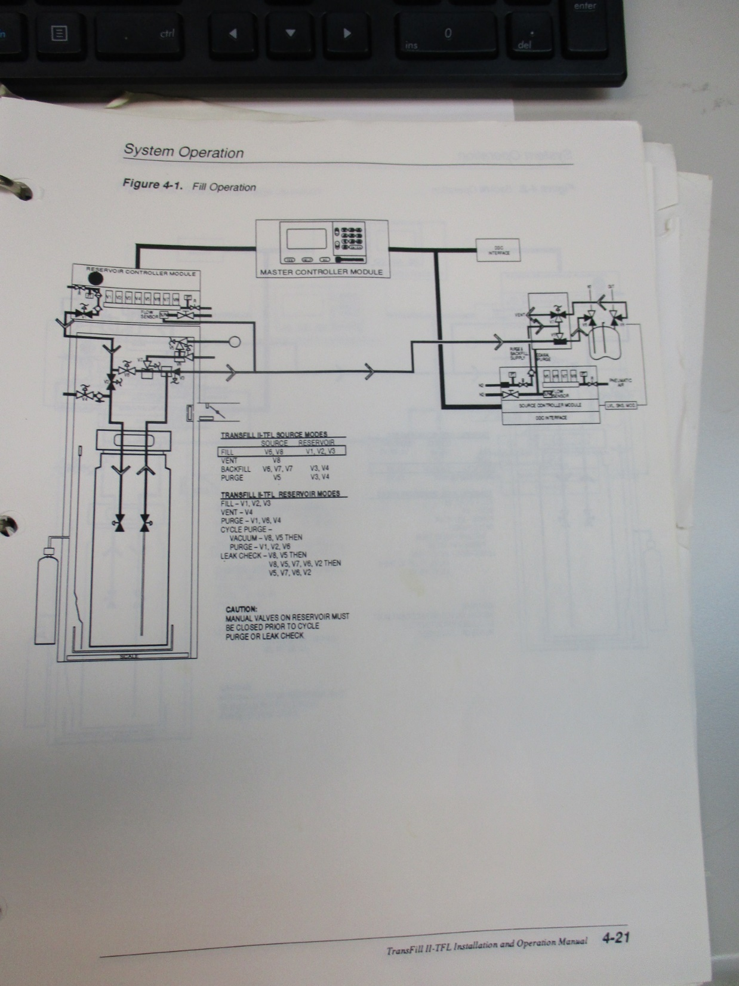
三、RCM 管路圖
N2
V6
V8
V1
V2
V3

Slide 6
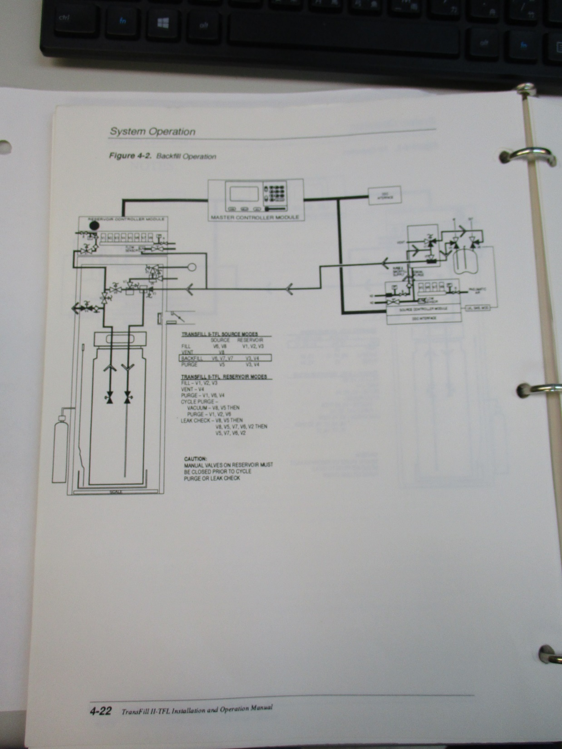
V6
V8
V7
V3
V4

Slide 7
四、RCM FILL/BACKFILL 操作流程
SCHUMACHER.
RESERVOIR |  |  |  | SCRS | 6 | SHOW DATA
#2 15836G | 70% | IDLE |  | #72 | 72% | OPERATE PG1
 |  |  |  | #70 | 71% | OPERATE PG2
 |  |  |  | #69 | 50% | ISPLAY
 |  |  |  | #68 | 50% | SETUP
RES'S: 4 | SRC'S:24 |  |  | #67 | 50% | GNOSICS
#1 7962G | 35% | IDLE |  | #66 | 50%
#2 15836G | 70% | IDLE
#3 7962G | 58% | IDLE
#4 7962G | 30% | IDLE |  |  |  | RES:2 ST:74
 |  |  |  |  |  | CHEM:TRNS
1.開啟RCM 操作面板
2.點選SHOW DATA
3.出現USER PRESERVOIR ID
SCHUMACHER.
RESERVOIR |  |  |  | SCRS | 6 | SHOW DATA
#2 15836G | 70% | IDLE |  | #72 | 72% | OPERATE PG1
 |  |  |  | #70 | 71% | OPERATE PG2
 |  |  |  | #69 | 50% | ISPLAY
 |  |  |  | #68 | 50% | SETUP
RES'S: 4 | SRC'S:24 |  |  | #67 | 50% | GNOSICS
#1 7962G | 35% | IDLE |  | #66 | 50%
#2 15836G | 70% | IDLE
#3 7962G | 58% | IDLE
#4 7962G | 30% | IDLE |  |  |  | RES:2 ST:74
 |  |  |  |  |  | CHEM:TRNS
2
USER PRESERVOIR |  | ID: | 1
3

Slide 8
SCHUMACHER.
RESERVOIR |  |  |  | #76 | 55% | SHOW DATA
#1 7962G | 35% | IDLE |  | #75 | 56% | OPERATE PG1
 |  |  |  | #74 | 81% | OPERATE PG2
 |  |  |  | #73 | 0% | ISPLAY
 |  |  |  | #71 | 67% | SETUP
RES'S: 4 | SRC'S:24 |  |  | #6 | 77% | GNOSICS
#1 7962G | 35% | IDLE
#2 15836G | 70% | IDLE
#3 7962G | 58% | IDLE
#4 7962G | 30% | IDLE |  |  |  | RES:2 ST:74
 |  |  |  |  |  | CHEM:TRNS
4
5
4.確認切換RCM機台OK
5.確認為IDLE 狀態
6.選擇SETUP
7.輸入密碼8108
SCHUMACHER.
RESERVOIR |  |  |  | #76 | 55% | SHOW DATA
#1 7962G | 35% | IDLE |  | #75 | 56% | OPERATE PG1
 |  |  |  | #74 | 81% | OPERATE PG2
 |  |  |  | #73 | 0% | ISPLAY
 |  |  |  | #71 | 67% | SETUP
RES'S: 4 | SRC'S:24 |  |  | #6 | 77% | GNOSICS
#1 7962G | 35% | IDLE
#2 15836G | 70% | IDLE
#3 7962G | 58% | IDLE
#4 7962G | 30% | IDLE |  |  |  | RES:2 ST:74
 |  |  |  |  |  | CHEM:TRNS
6
ENTER PASSWORD:______
7

Slide 9
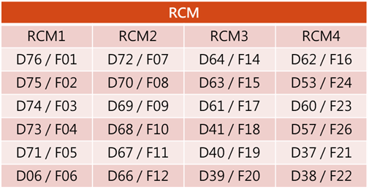
SCHUMACHER.
RESERVOIR |  |  |  | SCRS | 6 | SETUP
#2 15836G | 70% | IDLE |  | #72 | 72% | PESERVOIR
 |  |  |  | #70 | 71% | SOURCES
 |  |  |  | #69 | 50% | LEAK CHECK
 |  |  |  | #68 | 50% | SYSTEM
RES'S: 4 | SRC'S:24 |  |  | #67 | 50% | GROUPS
#1 7962G | 35% | IDLE |  | #66 | 50% | PASSWORDS
#2 15836G | 70% | IDLE |  |  |  | RETURN
#3 7962G | 58% | IDLE
#4 7962G | 30% | IDLE |  |  |  | RES:2 ST:74
 |  |  |  |  |  | CHEM:TRNS
8.點選SOURCES
9.更改對應機台編碼
8
SCHUMACHER.
SOUECE ID |  | 76 |  | SCRS | 6 | SETUP
ADDRESS |  | 76 |  | #72 | 72% | PESERVOIR
FILL MODE |  | MANUAL |  | #70 | 71% | SOURCES
OP MODE |  | NONVAC |  | #69 | 50% | LEAK CHECK
FILLS B4 BKF |  | 0 |  | #68 | 50% | SYSTEM
LEV CHK TIME |  | 30 |  | #67 | 50% | GROUPS
PURGE LPM |  | 0 |  | #66 | 50% | PASSWORDS
FULL LEVEL |  | 80% |  |  |  | RETURN
EMPTY LEVEL |  | 50%
HOLE LEVEL |  | 0% |  |  |  | RES:2 ST:74
FILL TIMEOUT |  | 60 | SECONDS |  |  | CHEM:TRNS
10.更改FILL MODE,選擇4 CONTINUE→MANUAL
11. OP MODE 保持NONVAC選擇2
12.重複8～12步驟，將RCM所對應機台FILL MODE 全數改為MANUAL
9
10
11

Slide 10
SCHUMACHER.
SOUECE ID |  | 76 |  | SCRS | 6 | SETUP
ADDRESS |  | 76 |  | #72 | 72% | PESERVOIR
FILL MODE |  | MANUAL |  | #70 | 71% | SOURCES
OP MODE |  | NONVAC |  | #69 | 50% | LEAK CHECK
FILLS B4 BKF |  | 0 |  | #68 | 50% | SYSTEM
LEV CHK TIME |  | 30 |  | #67 | 50% | GROUPS
PURGE LPM |  | 0 |  | #66 | 50% | PASSWORDS
FULL LEVEL |  | 80% |  |  |  | RETURN
EMPTY LEVEL |  | 50%
HOLE LEVEL |  | 0% |  |  |  | RES:2 ST:74
FILL TIMEOUT |  | 60 | SECONDS |  |  | CHEM:TRNS
13
13.選擇RETURN 回至前一畫面
14.選擇OPERATE PG1
15.輸入密碼8108
SCHUMACHER.
RESERVOIR |  |  |  | #76 | 55% | SHOW DATA
#1 7962G | 35% | IDLE |  | #75 | 56% | OPERATE PG1
 |  |  |  | #74 | 81% | OPERATE PG2
 |  |  |  | #73 | 0% | ISPLAY
 |  |  |  | #71 | 67% | SETUP
RES'S: 4 | SRC'S:24 |  |  | #6 | 77% | GNOSICS
#1 7962G | 35% | IDLE
#2 15836G | 70% | IDLE
#3 7962G | 58% | IDLE
#4 7962G | 30% | IDLE |  |  |  | RES:2 ST:74
 |  |  |  |  |  | CHEM:TRNS
14
ENTER PASSWORD:______
15

Slide 11
SCHUMACHER.
RESERVOIR |  |  |  | #76 | 55% | OPERATE PG1
#1 7962G | 35% | IDLE |  | #75 | 56% | OPERATE PG2
 |  |  |  | #74 | 81% | TERMAINATE
 |  |  |  | #73 | 0% | FILL
 |  |  |  | #71 | 67% | BACKFILL
RES'S: 4 | SRC'S:24 |  |  | #6 | 77% | LINE PURGE
#1 7962G | 35% | IDLE |  |  |  | RES VENT
#2 15836G | 70% | IDLE |  |  |  | CTCLE PURGE
#3 7962G | 58% | IDLE |  |  |  | LEAK CHECK
#4 7962G | 30% | IDLE |  |  |  | RETURN
 |  |  |  |  |  | RES:2 ST:74
 |  |  |  |  |  | CHEM:TRNS
16.選擇FILL
16
SCHUMACHER.
RESERVOIR |  |  |  | #76 | 55% | OPERATE PG1
#1 7962G | 35% | IDLE |  | #75 | 56% | OPERATE PG2
 |  |  |  | #74 | 81% | TERMAINATE
 |  |  |  | #73 | 0% | FILL
 |  |  |  | #71 | 67% | BACKFILL
RES'S: 4 | SRC'S:24 |  |  | #6 | 77% | LINE PURGE
#1 7962G | 35% | IDLE |  |  |  | RES VENT
#2 15836G | 70% | IDLE |  |  |  | CTCLE PURGE
#3 7962G | 58% | IDLE |  |  |  | LEAK CHECK
#4 7962G | 30% | IDLE |  |  |  | RETURN
 |  |  |  |  |  | RES:2 ST:74
 |  |  |  |  |  | CHEM:TRNS
17.輸入欲填充對應之RCM鋼瓶櫃及機台編碼，並開始填充，待填充完畢
ENTER OESERVOIR ID: |  |  | 1
ENTER SOURCE/TOOL ID: |  |  | 76
17

Slide 12
SCHUMACHER.
RESERVOIR |  |  |  | #76 | 55% | OPERATE PG1
#1 7962G | 35% | IDLE |  | #75 | 56% | OPERATE PG2
 |  |  |  | #74 | 81% | TERMAINATE
 |  |  |  | #73 | 0% | FILL
 |  |  |  | #71 | 67% | BACKFILL
RES'S: 4 | SRC'S:24 |  |  | #6 | 77% | LINE PURGE
#1 7962G | 35% | IDLE |  |  |  | RES VENT
#2 15836G | 70% | IDLE |  |  |  | CTCLE PURGE
#3 7962G | 58% | IDLE |  |  |  | LEAK CHECK
#4 7962G | 30% | IDLE |  |  |  | RETURN
 |  |  |  |  |  | RES:2 ST:74
 |  |  |  |  |  | CHEM:TRNS
18.選擇BACKFILL
SCHUMACHER.
RESERVOIR |  |  |  | #76 | 55% | OPERATE PG1
#1 7962G | 35% | IDLE |  | #75 | 56% | OPERATE PG2
 |  |  |  | #74 | 81% | TERMAINATE
 |  |  |  | #73 | 0% | FILL
 |  |  |  | #71 | 67% | BACKFILL
RES'S: 4 | SRC'S:24 |  |  | #6 | 77% | LINE PURGE
#1 7962G | 35% | IDLE |  |  |  | RES VENT
#2 15836G | 70% | IDLE |  |  |  | CTCLE PURGE
#3 7962G | 58% | IDLE |  |  |  | LEAK CHECK
#4 7962G | 30% | IDLE |  |  |  | RETURN
 |  |  |  |  |  | RES:2 ST:74
 |  |  |  |  |  | CHEM:TRNS
19.輸入欲回填對應之RCM鋼瓶櫃及機台編碼，並開始回填，待回填完畢
ENTER OESERVOIR ID: |  |  | 1
ENTER SOURCE/TOOL ID: |  |  | 76

Slide 13
Thank you

